Slide 1
Third Week Feedback Qualtrics
Dear Students, It is important to us to determine how well we are meeting student needs. Accordingly, we are asking you to fill out a Qualtrics Survey, anonymously, at the end of the third-week of classes by following the link within this email. Responses will be reviewed and turned over to your instructor once the survey has been closed. Please consider making written comments. We want to make all our courses as interesting and rewarding as possible, but that requires your feedback. This Third Week Feedback survey will be open from 2/5/18 6:00 am to 2/16/18 11:59 pm.
Follow this link to the Survey: Take the Survey
Or copy and paste the URL below into your internet browser:
https://maryville.az1.qualtrics.com/jfe/form/SV_4OBEFIiZbZ1WTJ3
Thanks,
Rainier Edwards, MBA
Academic Systems Specialist

Slide 2
Randomized Block Design
Week 4

Slide 3
Randomization Block Designs
For all one blocking classification designs:
Randomization of treatments to experimental units takes place within each block.
Experimental units are grouped into blocks according to known or unknown variation which can be isolated by the blocks
A separate randomization is required for each block.
The design is said to have one restriction on randomization.
Comparison: A completely randomized design requires only one randomization.

Slide 4
Analysis of a RBD
Traditional analysis approach is via the linear (regression on indicator variables) model and AOV.
A RBD can occur in a number of situations:
A randomized block design with each treatment replicated once in each block (balanced and complete). This is a randomized complete block design (RCBD).
A randomized block design with each treatment replicated once in a block but with one block/treatment combination missing. (BIBD).
A randomized block design with each treatment replicated two or more times in each block (balanced and complete, with replication in each block) (RCBD with replications)

Slide 5
Single Replicate RCBD
Design: Complete (every treatment occurs in every block) block layout with each treatment replicated once in each block (balanced).
Data:
Block
Treatment 1 2 3 ... b
1 y11 y12 y13 ... y1b
2 y21 y22 y23 ... y2b
... ... ... ... ... ...
t yt1 yt2 yt3 ... ytb

Slide 6
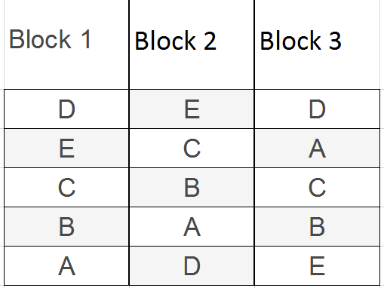
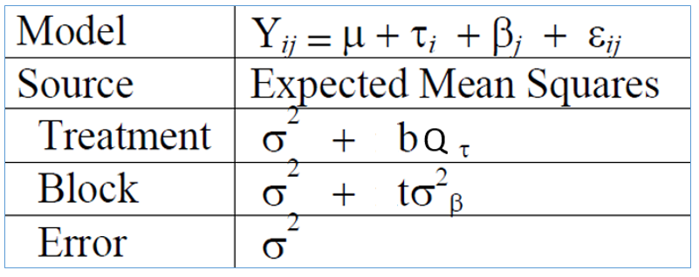
RBD Experiment Layout
RBD: Three blocks (b=3) and five treatment
levels (t=5) where each block has 5 cells
(experimental units) and each treatment occurs
once in each block and each is sampled once.
RBD with experimental error only
The most preferred Design

Slide 7
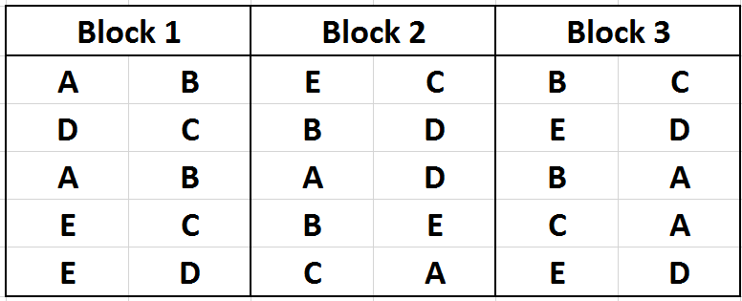
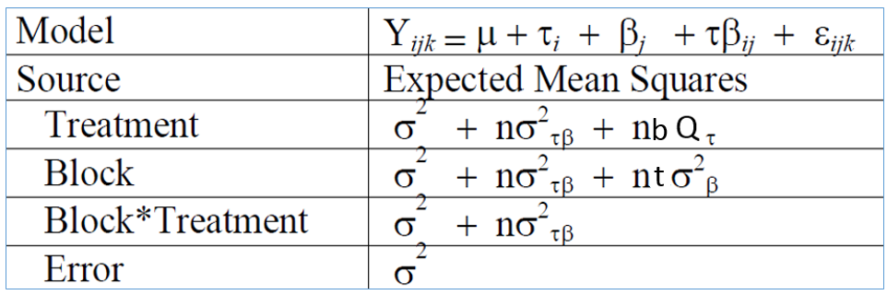
RBD Experiment Layout with Replications
RBD: Blocks=3, Treatment levels=5;
each block has 10 cells and each
treatment occurs twice in each block.
Each cell (treatment by block and within
block replicate combination) is sampled
once. In this case the residual error term
measures between cell variation.
b t
Waste of resources, not a good design in most case for field experiments
In controlled lab experiment, OK

Slide 8
RCBD Example
*** Example of RBD ***;
*** From Snedecor & Cochran, 1980 (pg 256) ***;
proc GLM data=SOYBEAN;
class treatment block;
model failures = treatment block;
random block;
output out=soybeanm p=pred r=resid;
lsmeans treatment / pdiff adjust=tukey;
contrast 'check vs fermate' treatment 0 -1 1 0 0;
run;
DATA SOYBEAN;
INPUT treatment $ BLOCK $ FAILURES;
TITLE1 'FAILURES TO GERMINATE OF SOYBEAN PLANTS';
TITLE2 '4 TREATMENTS AND A CONTROL, 5 BLOCKS';
CARDS;
CHECK 1 8
CHECK 2 10
CHECK 3 12
CHECK 4 13
CHECK 5 11
ARASAN 1 2
ARASAN 2 6
ARASAN 3 7
ARASAN 4 11
ARASAN 5 5
SPERGON 1 4
SPERGON 2 10
SPERGON 3 9
SPERGON 4 8
SPERGON 5 10
SEMESAN 1 3
SEMESAN 2 5
SEMESAN 3 9
SEMESAN 4 10
SEMESAN 5 6
FERMATE 1 9
FERMATE 2 7
FERMATE 3 5
FERMATE 4 5
FERMATE 5 3
;
PROC MIXED DATA=SOYBEAN cl COVTEST;
CLASS treatment BLOCK;
MODEL FAILURES = treatment / htype=3 DDFM=Satterthwaite outp=ResidDataP;
RANDOM BLOCK;
lsmeans treatment / pdiff adjust=tukey;
contrast 'check vs fermate' treatment 0 -1 1 0 0;
RUN;
proc univariate data=ResidDataP plot normal; var resid;
run;
proc plot data=soybeanm;
plot resid*pred/vref=0;
plot failures*pred;
run;

Slide 9
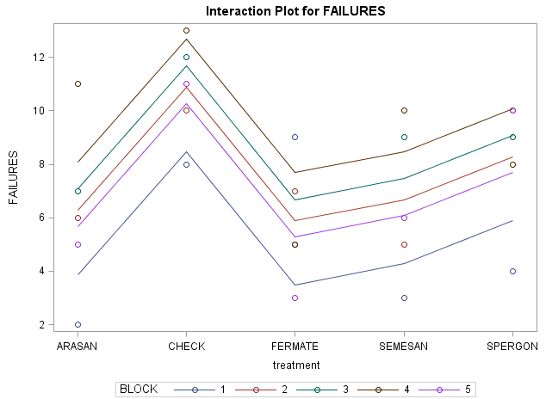
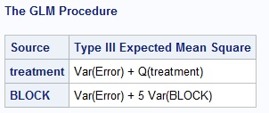
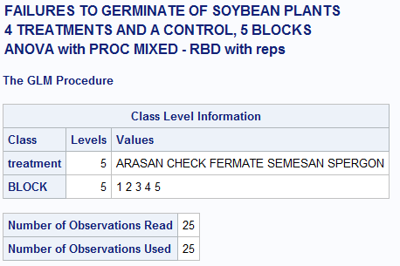
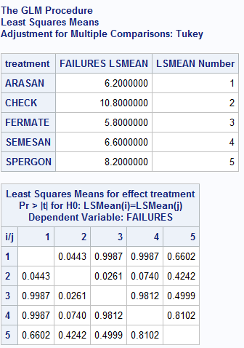
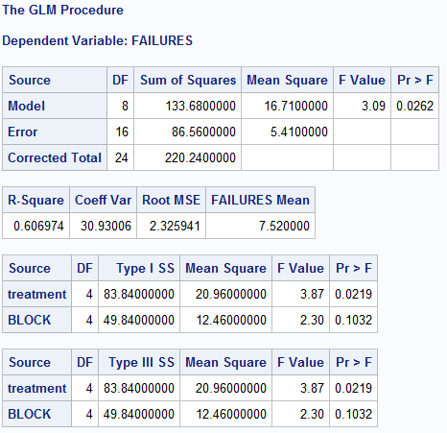
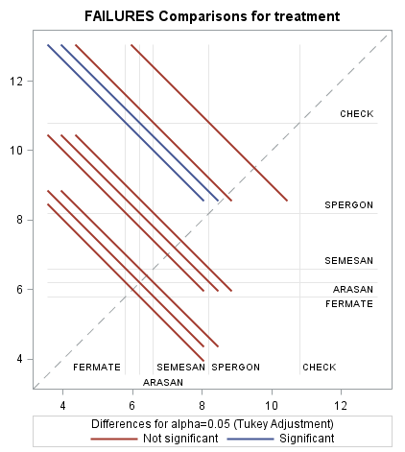
SAS Output

Slide 10
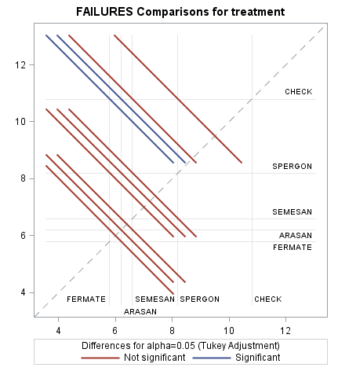
How to read a Mean-Mean Scatter Plot (Diffogram)
A significant difference between pairs of lsmeans (i.e., the adjusted pvalue is less than 0.05) occurs when the adjusted lower and upper endpoints of the confidence intervals are both positive or both negative; that is, the solid lines sloping at -45 degrees fall completely above or below the line of equality.

Slide 11
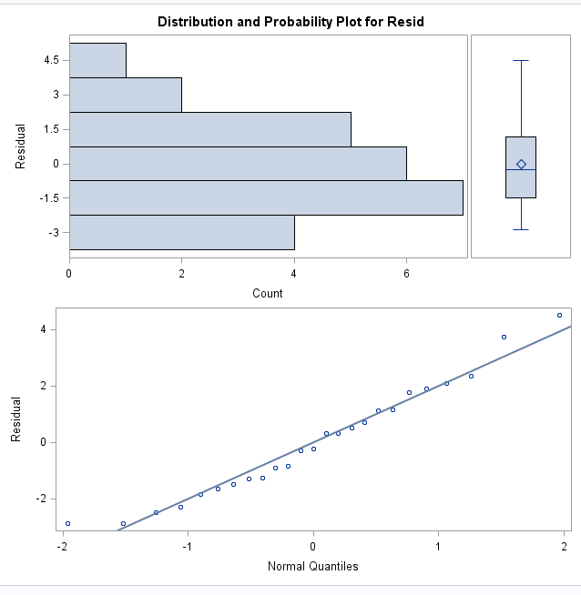
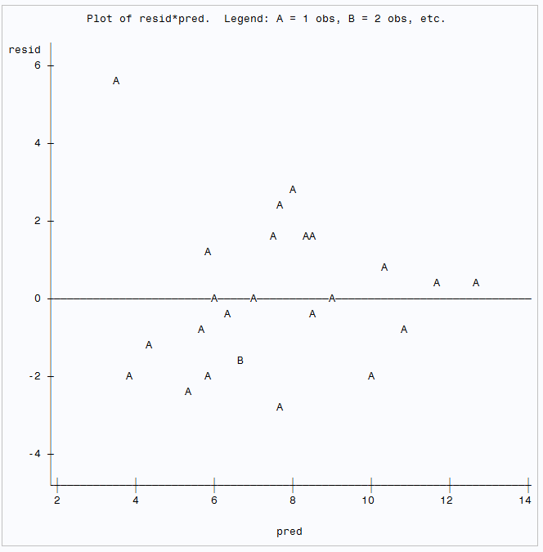
Diagnostic Plots
proc univariate data=ResidDataP plot normal; var resid;
run;
proc plot data=soybeanm;
plot resid*pred/vref=0;
plot failures*pred;
run;

Slide 12
RCBD with Replication
DATA FUMIGANT;
INPUT FUMIGANT $ BLOCK $ REP WORMS LWORMS;
CARDS;
C I 1 5 1.79176
C I 2 4 1.60944
C I 3 5 1.79176
C I 4 2 1.09861
C II 1 0 0
C II 2 9 2.30259
C II 3 3 1.38629
C II 4 3 1.38629
C III 1 4 1.60944
C III 2 4 1.60944
C III 3 3 1.38629
C III 4 9 2.30259
C IV 1 7 2.07944
C IV 2 3 1.38629
C IV 3 5 1.79176
C IV 4 12 2.56495
C V 1 4 1.60944
C V 2 9 2.30259
C V 3 8 2.19722
C V 4 6 1.94591
S I 1 5 1.79176
S I 2 5 1.79176
S I 3 1 0.69315
S I 4 2 1.09861
S II 1 6 1.94591
S II 2 4 1.60944
S II 3 5 1.79176
S II 4 4 1.60944
S III 1 2 1.09861
S III 2 9 2.30259
S III 3 3 1.38629
S III 4 7 2.07944
S IV 1 6 1.94591
S IV 2 4 1.60944
S IV 3 8 2.19722
S IV 4 4 1.60944
S V 1 2 1.09861
S V 2 9 2.30259
S V 3 7 2.07944
S V 4 3 1.38629
0 I 1 12 2.56495
0 I 2 20 3.04452
0 I 3 8 2.19722
0 I 4 8 2.19722
0 II 1 7 2.07944
0 II 2 4 1.60944
0 II 3 4 1.60944
0 II 4 5 1.79176
0 III 1 9 2.30259
0 III 2 6 1.94591
0 III 3 7 2.07944
0 III 4 11 2.48491
0 IV 1 12 2.56495
0 IV 2 22 3.13549
0 IV 3 17 2.89037
0 IV 4 13 2.63906
0 V 1 7 2.07944
0 V 2 8 2.19722
0 V 3 5 1.79176
0 V 4 9 2.30259
run;

Slide 13
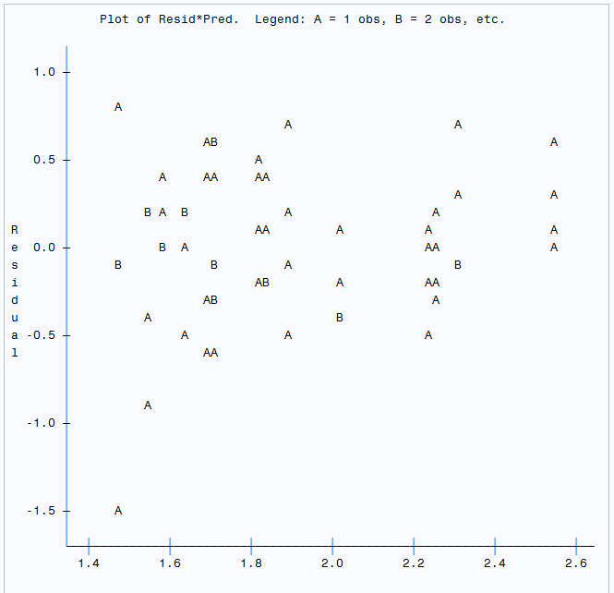
RCBD with Replication
proc univariate data=ResidDataP plot normal; var resid;
TITLE3 'Univariate analysis for PROC MIXED - RBD with reps';
run;
PROC GLM DATA=FUMIGANT; CLASS FUMIGANT BLOCK REP;
model Lworms = Fumigant block Fumigant*block;
random block Fumigant*block;
output out=fumigantm p=pred r=resid;
run;
proc plot data=residdatap;
plot resid*pred;
run;
PROC mixed DATA=FUMIGANT cl COVTEST;
CLASS FUMIGANT BLOCK REP;
MODEL WORMS = FUMIGANT / htype=3 DDFM=Satterthwaite outp=ResidDataP outpM=ResidDataPM;
RANDOM BLOCK FUMIGANT*BLOCK/solution;
lsmeans fumigant / pdiff ADJUST=DUNNETT diff=controll('0');
lsmeans fumigant / pdiff ADJUST=tukey;
RUN;

Slide 14
Exercise for the students
Analyze the Alfalfa data from the textbook
Using both SAS GLM and SAS MIXED
Please prepare to answer these questions
What is the order of the 4 varieties in the analysis (important for build the right contrast)
What is the percentage of variation can be explained by the model
Write down the ANOVA table, including the EMS for each factor
can we reject the null hypothesis that neither variety is significant different from the rest?
generate the contrast to compare Narrag. with the average of the rest varieties
Generate the residual plot

Slide 15
proc glm data=alfalfa;
class block variety;
model Yield= block variety block*variety/solution;
test h=variety e=block*variety;
output out=alfalfalm p=pred r=resid;
random block block*variety;
lsmeans variety/pdiff e=block*variety;
lsmeans variety /tukey lsd e=block*variety;
contrast 'variety Ladak vs. variety Narrag.' variety 0 0 1 -1/e=block*variety;
options linesize=80 pagesize=54 nocenter nodate nonumber;
proc plot data=alfalfalm;
plot resid*pred/vref=0;
plot Yield*pred/vref=1;
run;

Slide 16
Quiz 3 – Alfalfa Data
Write down the ANOVA table with EMS for each factor (4 points)
What is the percentage of variation can be explained by the model (show the calculation) (1 points)
Generate the contrast to compare Narrag. variety with Ladak variety (2 points)
Based on the residual plot in SAS, does the residual look like homogenous; if not, what do you propose on the new analysis? (3 points)

Slide 17
Project II –Randomized Block Design Analysis 2015-2018 Baseball Player Salary Analysis
https://www.usatoday.com/sports/mlb/salaries/
Dependent variable: Salary
Independent Variable: Playing Year, Team, Position
Covariate: Years in the team
Outcome of the project
Prepare the data
can discuss as a group, how to properly analyze the data
Present with high level summary of the project; including the model building and selection as well as diagnostics
Generate a slide deck of 15 slides, in a professional way, with additional backup slides as needed
Present the project on first week of April with each project 15 mins

